Slide 1
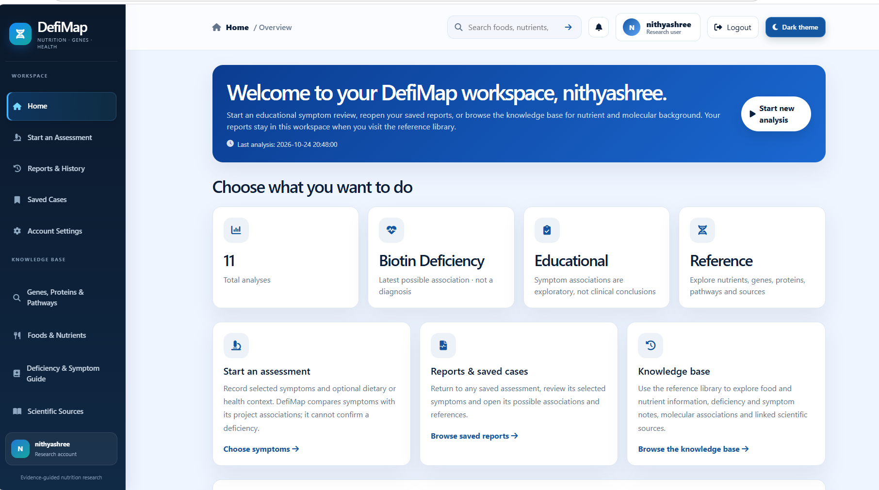
DefiMap
An Integrated Web-Based Platform for Nutritional Deficiency Detection, Dietary Assessment and Molecular Analysis
NITHYASHREE S K
Reg. No. 128013034 · B.Tech Bioinformatics
SASTRA Deemed to be University
Web Technology Project (V Semester)
Nutrition · Genes · Health
Notes:
Introduce yourself and the project: DefiMap is a PHP and MySQL website that brings symptoms, diet, lab results and molecular databases into one place. It is for education, not diagnosis.

Slide 2
Introduction
>50%
Key points
Nutrient deficiency is a common health problem
One symptom cannot prove a deficiency
Diet, labs and symptoms must be seen together
DefiMap brings them into one website
of women aged 15–49 are anaemic
~2/3
of children aged 6–59 months are anaemic
Source: NFHS-5 (2019–21)
Notes:
Anaemia and nutrient deficiency are common in India. Symptoms alone cannot prove a deficiency, so people need to look at diet, lab results and symptoms together. DefiMap puts all of this in one website.

Slide 3
Abstract
What it is
A PHP and MySQL website to explore possible nutrient deficiencies
1
How it works
User fills five tabs: symptoms, diet, labs, body details, notes
2
Evidence
Linked to NCBI Gene, UniProt, Reactome, PubMed and IFCT food tables
3
Safe to use
For education only, no diagnosis; records are private and secured
4
Notes:
Four simple points: what DefiMap is, how the user works with it, where the evidence comes from, and how it stays safe and educational.

Slide 4
Five Research Gaps
1
Single-input tools
Only a symptom list or calorie counter
2
Molecular data not linked
Curated databases rarely tied to a user assessment
3
Unexplained risk scores
Percentages shown with no stated basis
4
Missing read as normal
A blank lab field is not a normal result
5
History is confusing
Changed input is not changed health
Notes:
Explain each gap simply: existing tools use one input, are not linked to real databases, show unexplained percentages, treat blanks as normal, and mix up input changes with health changes.

Slide 5
Aim and Objectives
A responsive, login-protected website that turns symptoms, diet, lab results and background into a sourced, preliminary educational summary.
Exactly six PHP files
Secure sign-in and sign-out
Five-tab analysis workflow
Diet estimate from IFCT
Real gene, protein and pathway records
Preliminary results, no diagnosis
Private saved cases and comparison
One responsive, accessible design
Notes:
The aim is one login-protected, responsive website that gives a sourced, preliminary educational summary. The eight chips are the objectives in short.

Slide 6
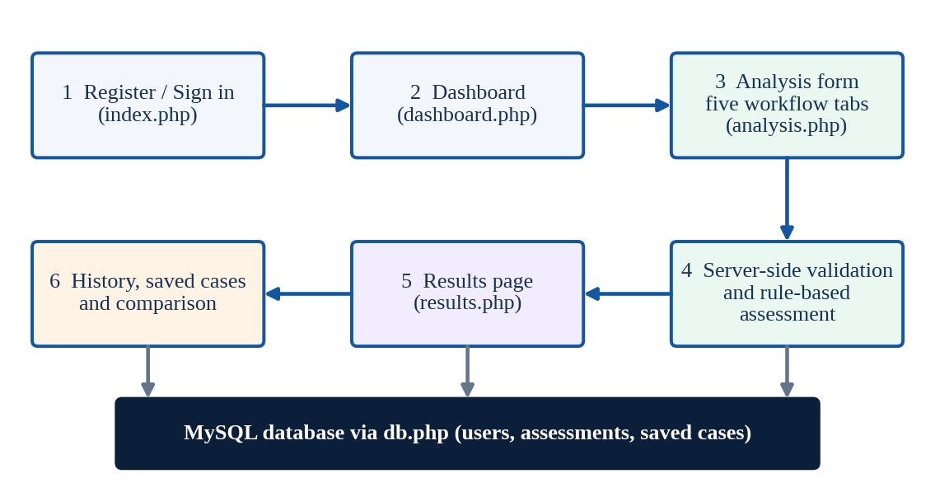
How a User Moves Through It
Sign in, then open the dashboard
Fill five tabs; the server validates
Results are saved in MySQL
History and comparison over time
Fig. 3.1 Overall workflow of DefiMap
Notes:
Follow the arrows: register or sign in, open the dashboard, fill the form, the server validates, results are shown, then history and comparison. Everything is stored in MySQL through db.php.

Slide 7
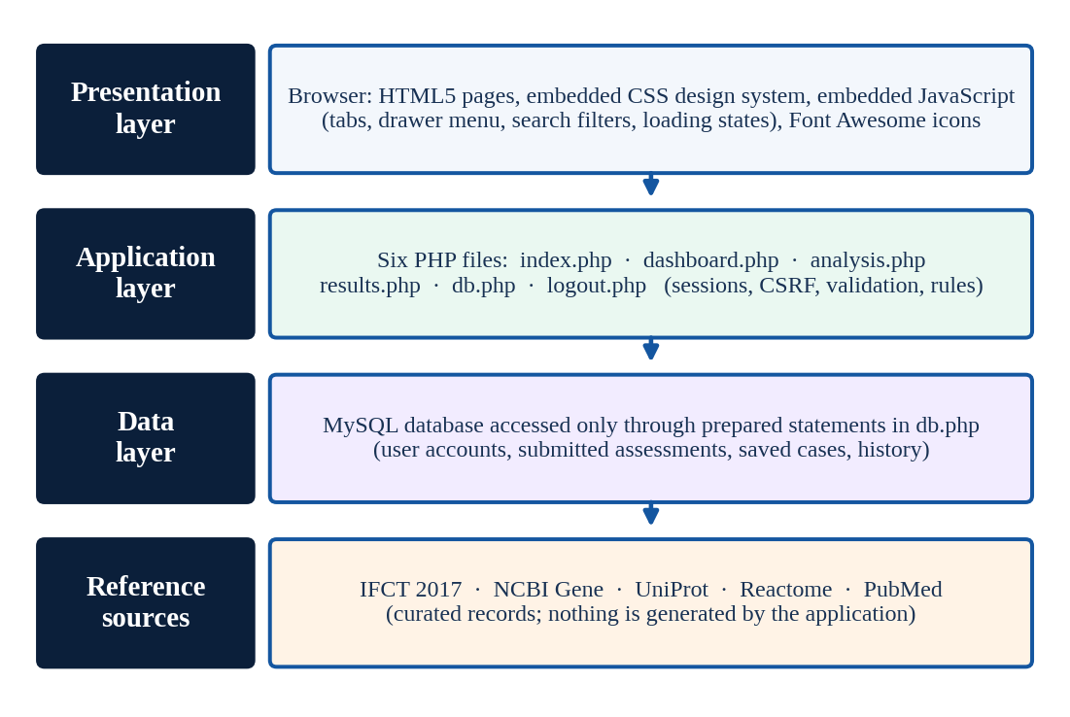
Four-Layer Architecture
Browser: HTML, CSS, JavaScript
Six PHP files hold the logic
MySQL stores accounts and cases
Reference sources supply data
Deploy = copy 6 files + import the database
Fig. 3.2 Layered architecture of DefiMap
Notes:
Four layers: browser, six PHP files, MySQL database, and curated reference sources. All database access goes through db.php. The six-file limit makes it easy to install: copy six files and import the database.

Slide 8
Technology Stack
PHP
MySQL
Prepared statements
Sessions, validation, assessment logic
Accounts, assessments, saved cases
User input never becomes SQL
HTML5
CSS3
JavaScript
Semantic, accessible pages
Grid, flexbox, colour tokens
Tabs, drawer menu, symptom search
Font Awesome
Apache server
Reference data
Interface icons via CDN
Local development and testing
IFCT, NCBI Gene, UniProt, Reactome, PubMed
Notes:
Walk through the grid quickly. Key point: prepared statements mean user input never becomes part of the SQL.

Slide 9
Where the Data Comes From
IFCT 2017
Nutrient values of Indian foods
→ Diet intake estimate
NCBI Gene
Gene symbols and IDs
→ Related Genes card
UniProt
Protein IDs and functions
→ Proteins card
Reactome
Curated biological pathways
→ Pathways card
PubMed
Publication references
→ Research Evidence card
No patient dataset: only user input plus curated public records
Notes:
DefiMap has no patient dataset of its own. It uses what the user types and records from five trusted public resources.

Slide 10
Five Input Tabs
1
2
3
4
5
Symptoms and Health
Dietary Intake
Lab Biomarkers
Body and Family History
Additional Info
Searchable symptom checklist
Food, quantity, unit, frequency
Test, result, unit, date, range
Height, weight, restrictions, family history
Diet background and notes
Blank field = "missing", never "normal"
Notes:
Each tab collects one kind of evidence. Anything left blank is reported as missing, never filled with a default and never read as normal.

Slide 11
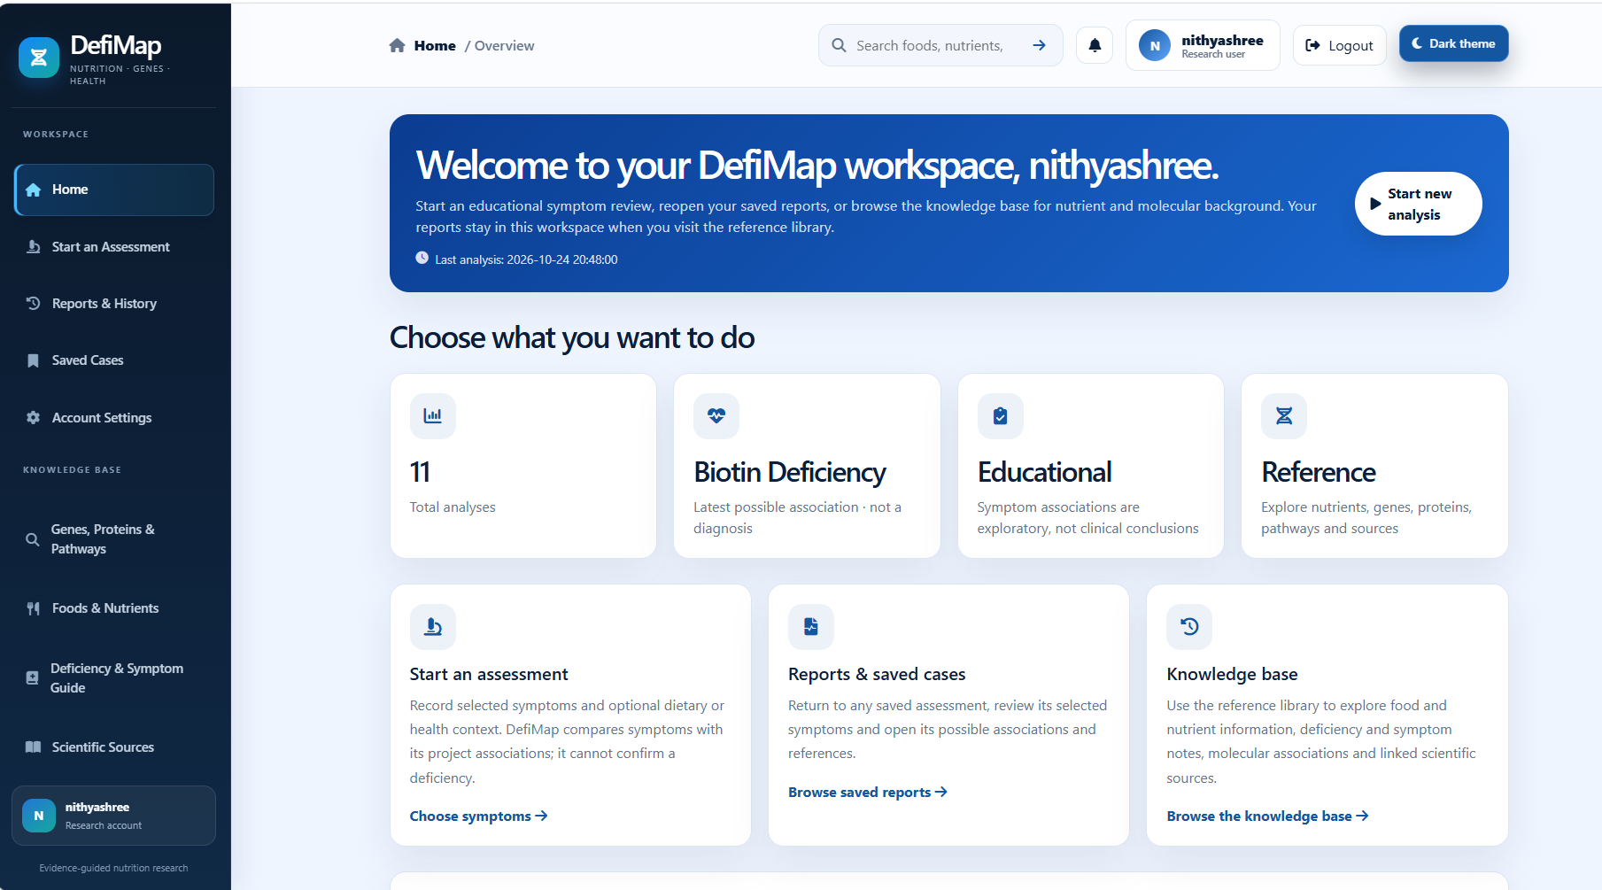
One Design System
Deep navy · sidebar
Primary blue · top bar
Action blue · buttons
Teal · dietary intake
Soft purple · lab biomarkers
Soft orange · body and family
Navy sidebar, blue top bar, white rounded cards
Notes:
The same navy, blue and teal palette is used on every page so the app feels like one healthcare product. Pastel colours tell sections apart: blue symptoms, teal diet, purple labs, orange body measures.

Slide 12
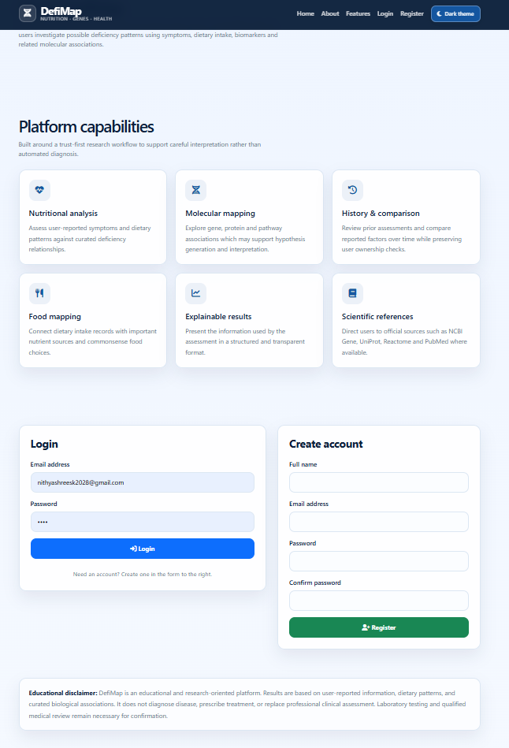
Sign-in and Dashboard
Fig. 4.1 Sign-in and registration
Fig. 4.2 Dashboard with navy sidebar and welcome card
Notes:
Visitors only see the sign-in page. After login the dashboard shows the sidebar, top bar and welcome card. The last-analysis date appears only if a real one exists.

Slide 13
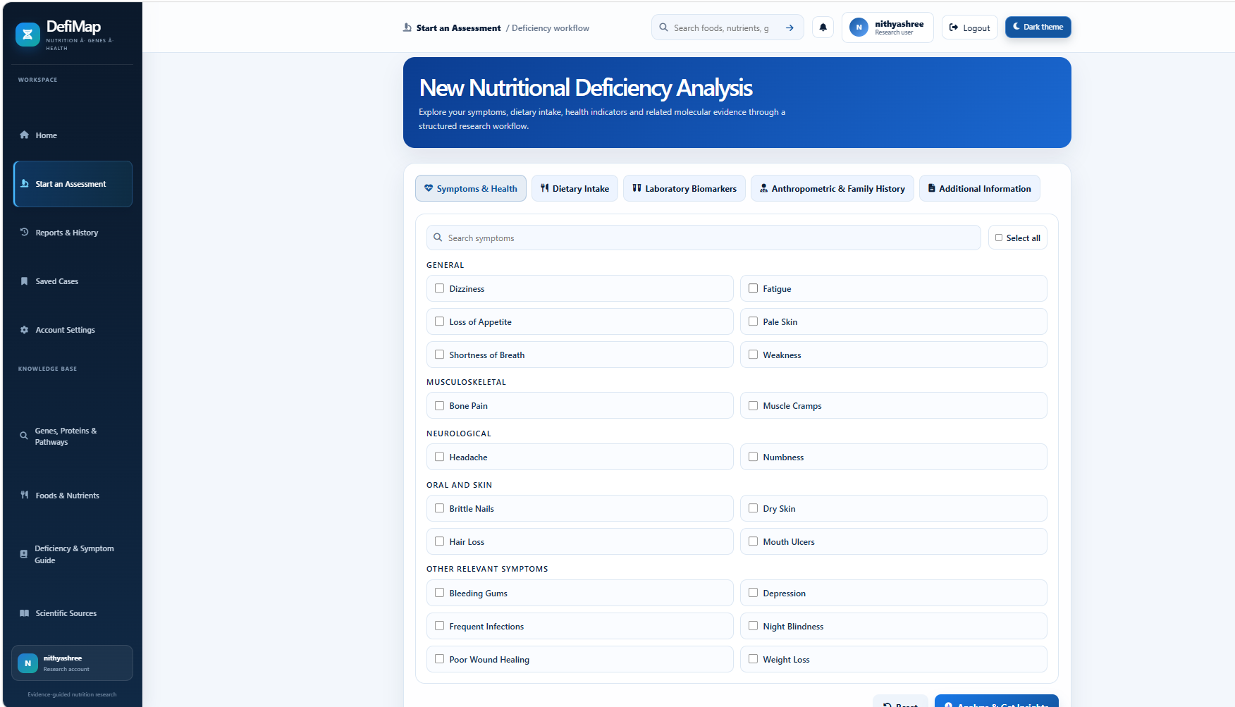
Analysis Workflow
Five tabs with icons
All tabs are one form: no data lost
Grouped, searchable symptoms
Reset and Analyze & Get Insights
Fig. 4.3 Symptoms and Health card
Notes:
The form has five tabs but is one form, so nothing is lost when switching. The Reset button is secondary; Analyze and Get Insights is primary and shows a loading state to stop double submission.

Slide 14
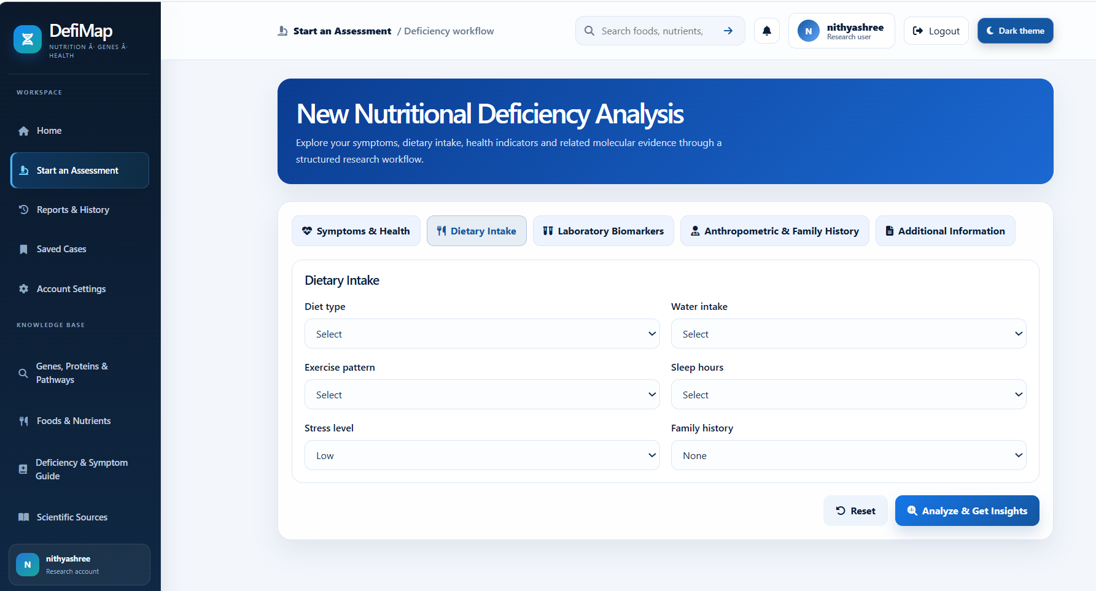
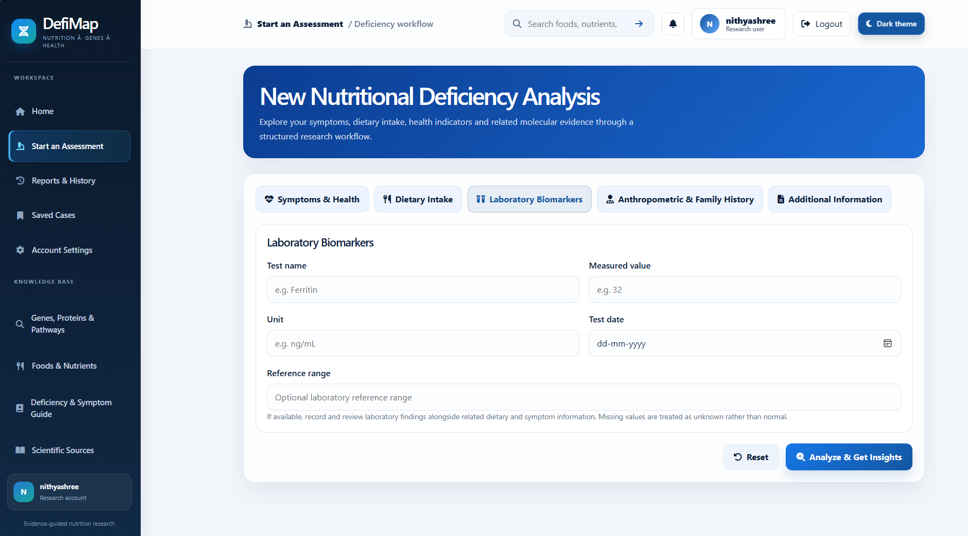
Diet and Lab Inputs
Dietary Intake: food, quantity, unit and frequency. Estimate only when a value exists.
Lab Biomarkers: unit and date beside each entry, with the lab's own range.
Notes:
Diet is estimated from food composition values only when a value exists; otherwise the food is marked not estimated. Lab entries always show unit, date and the lab's own reference range.

Slide 15
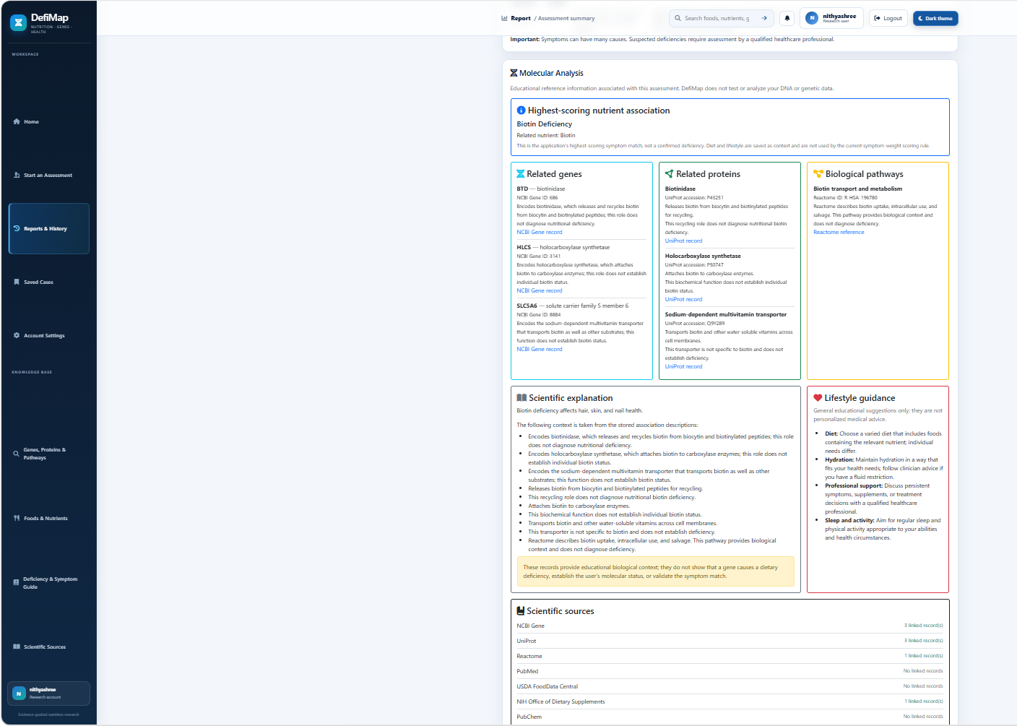
Molecular and Evidence Panel
Nutrient Overview
IFCT 2017
Related Genes
NCBI Gene
Proteins
UniProt
Biological Pathways
Reactome
Research Evidence
PubMed
No record? It says "not available". It never invents one.
Fig. 4.5 Evidence panel with Quick Insights
Notes:
Five cards connect the user input to real database records. If a source has no record the card says not available. An invented gene or reference would destroy trust.

Slide 16
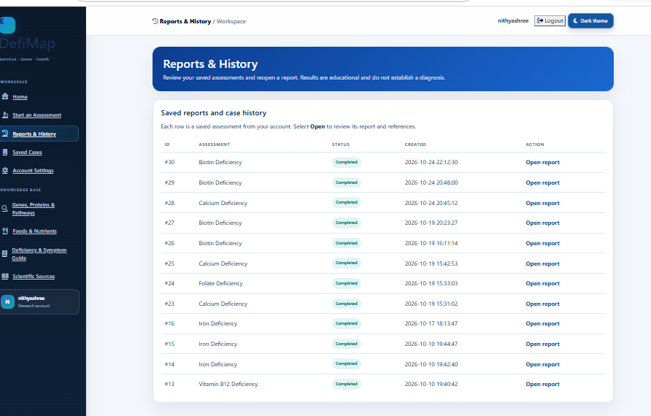
Results, History and Compare
Results in cards: summary, symptoms, diet, labs, concerns, evidence
Concerns are preliminary, not diagnoses
Past assessments can be reopened
Compare inputs side by side, not medical status
Fig. 4.6 History, saved cases and comparison
Notes:
Results are split into cards. Possible concerns are labelled preliminary educational findings. Comparison shows differences in what was entered, not whether a disease has progressed.

Slide 17
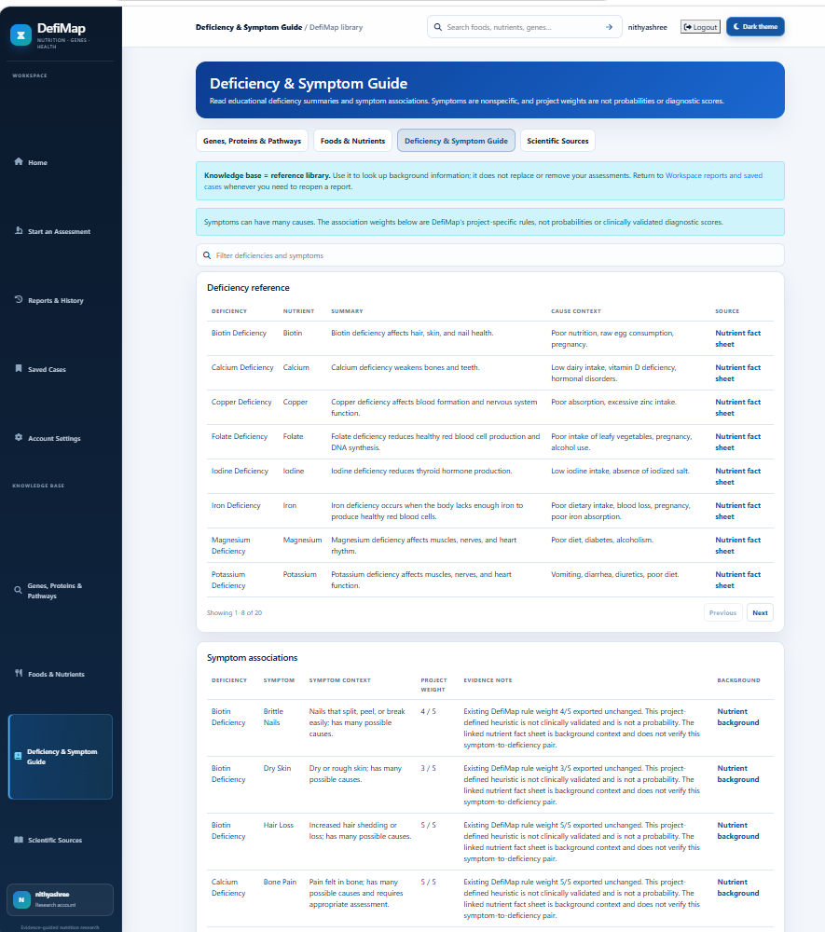
Knowledge Base Guide
What the guide lists
Each deficiency with its nutrient, summary, causes and a linked source
A second table of symptom associations
Weights are project rules, not probabilities or validated scores
Fig. 4.7 Deficiency and Symptom Guide
Notes:
The knowledge base is a reference library. Its weights are rules defined in this project, not probabilities or clinically validated scores, and the page says so.

Slide 18
Security and Data Protection
SQL injection
→
Prepared statements for every query
Cross-site scripting
→
Every user value is escaped
Cross-site request forgery
→
Token checked on every form
Weak passwords
→
Stored only as hashes
Broken access control
→
Sign-in needed; owner-only records
Bad or oversized input
→
Server-side validation, length limits
Notes:
Health data is sensitive, so security was designed in from the start. Each common web risk from the OWASP Top Ten has a matching control.

Slide 19
Safeguards, Access and Testing
Ethical safeguards
Accessible and responsive
Testing
No diagnosis or prescription
No invented values or risk %
Missing is never normal
Intake is not body level
Sidebar becomes a drawer
Labels, contrast, focus ring
Reduced-motion support
No sideways scrolling
Six-file inventory, syntax, SQL
Navigation and sign-in
Forms, ownership, validation
Desktop to phone widths
Notes:
Three groups: wording safeguards so the tool never sounds more certain than its evidence, accessibility and responsiveness, and the checks run on the working app.

Slide 20
Conclusion and Further Work
Achieved
Limitations
Further work
Working PHP and MySQL app in six files
Symptoms, diet and labs with real molecular evidence
Secure, private records; no invented values
Not clinically validated
Estimates only for foods with values
Panel shows only what sources record
Expert review and larger user tests
Age and sex based lab ranges
PDF export, regional languages, auto tests
Thank you · Questions?
Notes:
Summarise: it works, it is honest about gaps, and it is secure. It is not clinically validated, so next steps are expert review, wider food coverage and more testing. Thank the audience and invite questions.

